Slide 1


Slide 2
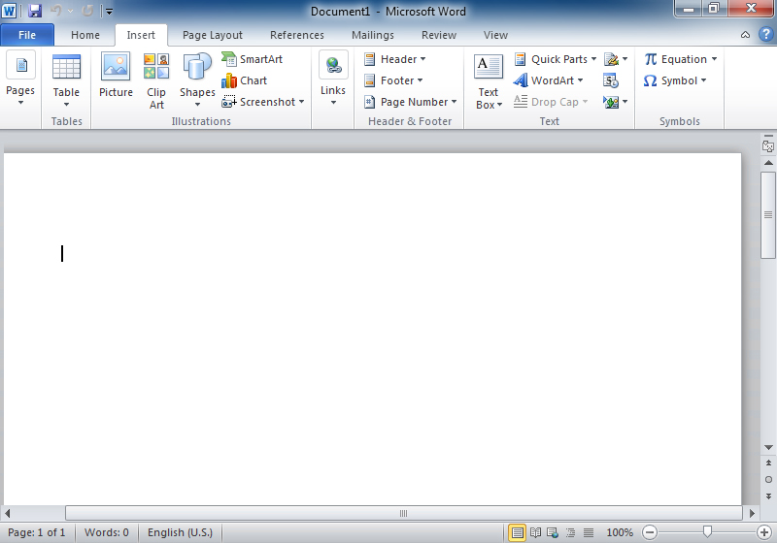
Introduction
Microsoft Word (often called Word) is a graphical word processing program that users can type with. It is made by the computer company Microsoft. The purpose of the MS Word is to allow the users to type and save documents.
Title bar
Menu bar
Document window
Scroll bar

Slide 3
Features of MS Word
Creating and saving a file
Editing and formatting a document
Paragraph formatting
Inserting header and footer and Page number
Checking spelling and grammar
Subscript and superscript
Inserting symbols
Print preview and printing
Inserting clipart, word art, and picture
Page setting
Bullets and number
Border and shading
Searching a word and replacing it by another word
Inserting table

Slide 4
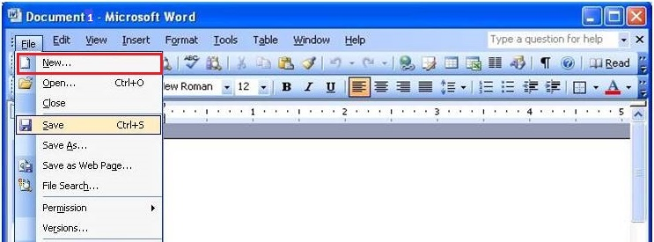
Creating and saving a file
Create new file (ctrl+N)
Save file(ctrl+s)

Slide 5
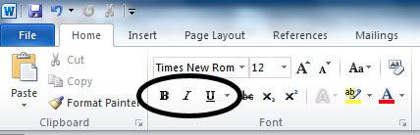
Editing and formating a document
Bold
Italic
Under Line
Normal

Slide 6
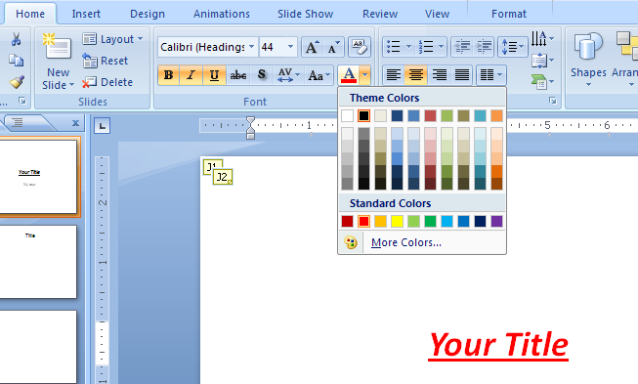
Font Type
Font Size
Font colour
Alignment of text

Slide 7
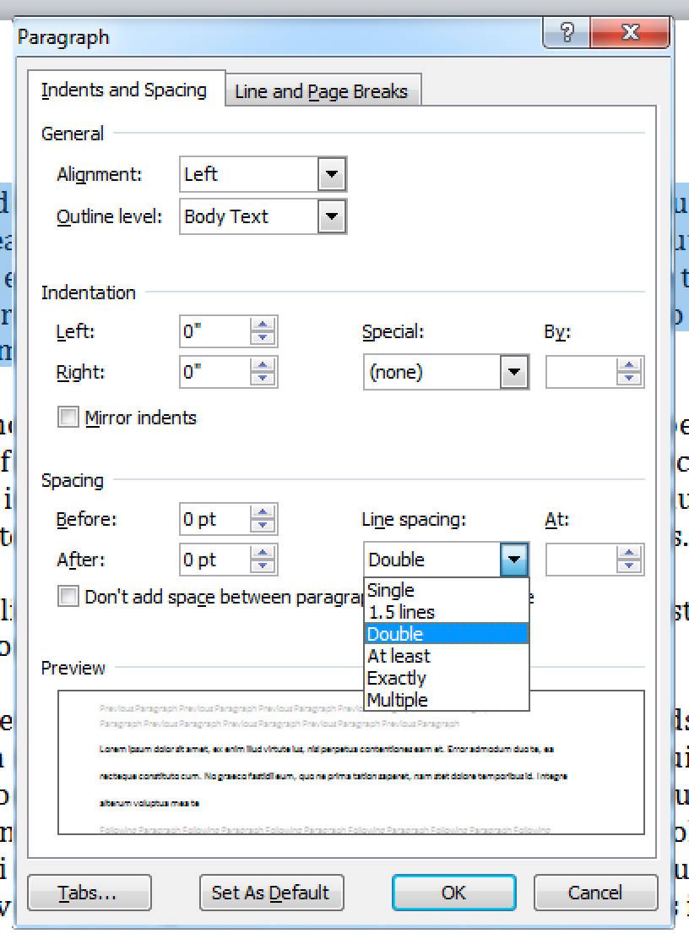
Paragraph formating
Alignment of Paragraph
Line spacing in paragraph
Space between Line

Slide 8
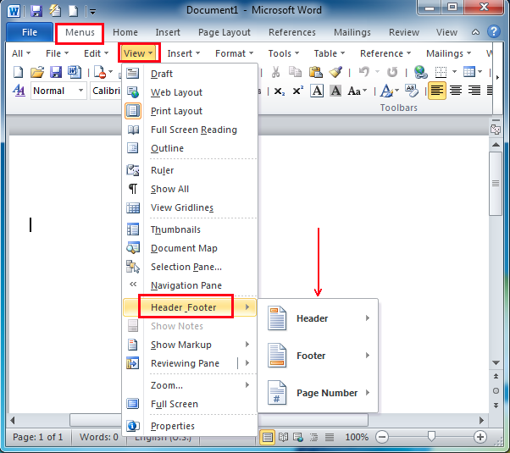
Inserting Header and Footer and page number

Slide 9
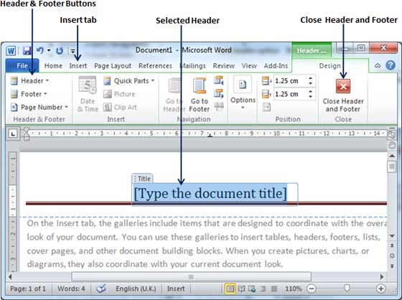

Slide 10
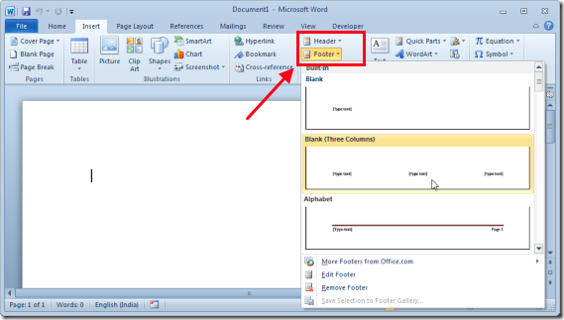
Insert Footer

Slide 11
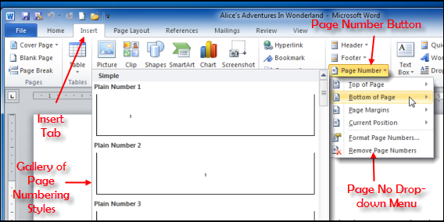

Slide 12
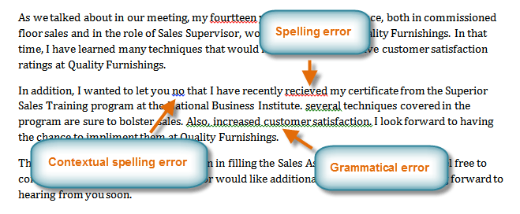
Checking Spelling and Grammer

Slide 13
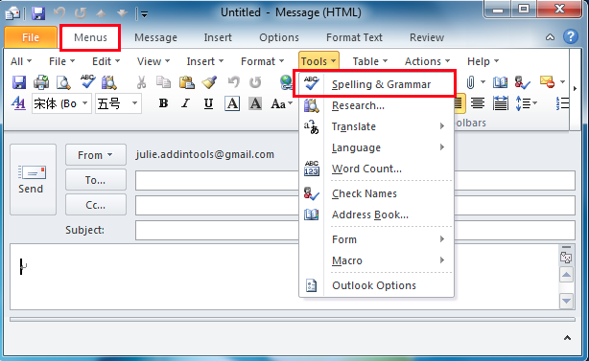

Slide 14
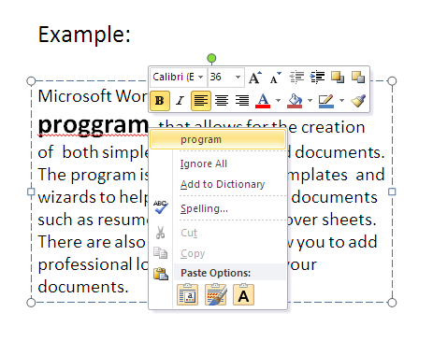

Slide 15
Subscript and Superscript
Superscript example: Per m³
Subscript example: Rate per month ₍₁₎

Slide 16
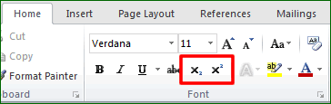
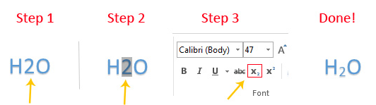
Subscript
Superscript
Type the text
Click the subscript
Success!
Select the text

Slide 17
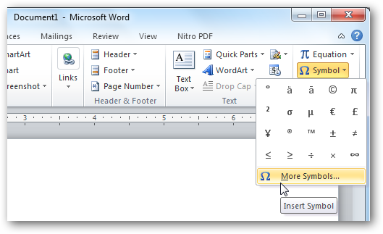
Inserting Symbols

Slide 18
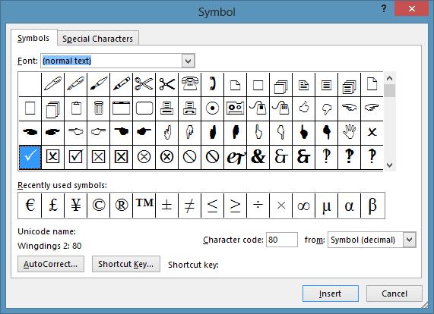
1. select the symbol
Click insert

Slide 19
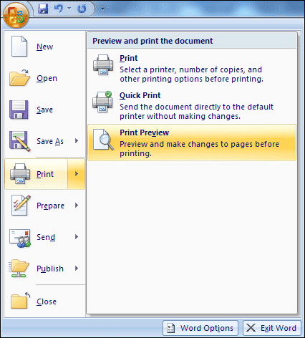
Print Preview and Printing
Print preview is used to make changes in document before printing

Slide 20
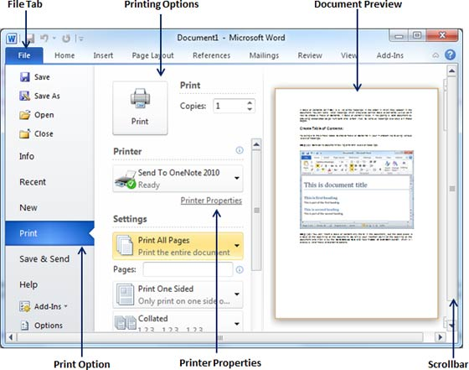

Slide 21

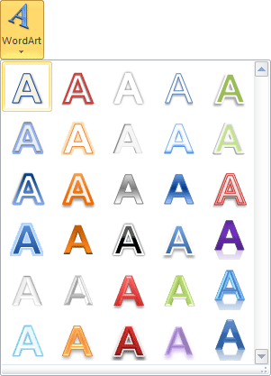
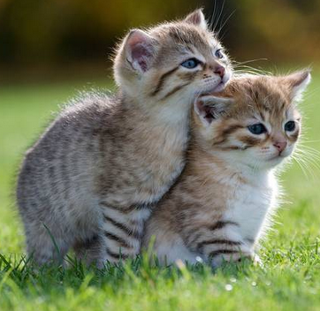
Inserting Clipart, Wordart, and Picture
Clipart
Wordart
Picture

Slide 22
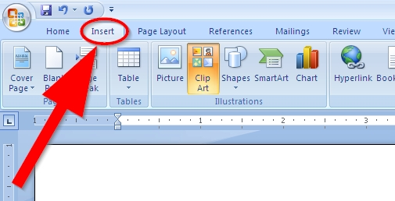
Then select the Clipart you want to insert

Slide 23
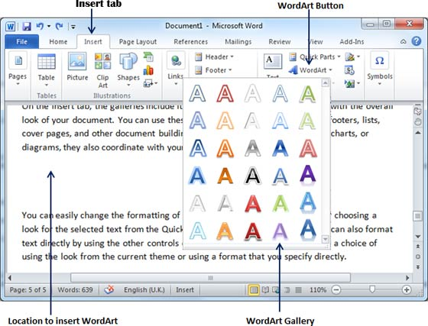

Slide 24
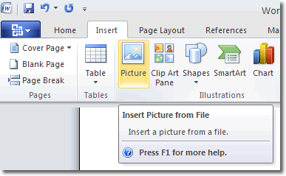
Then select the Picture you want to insert

Slide 25
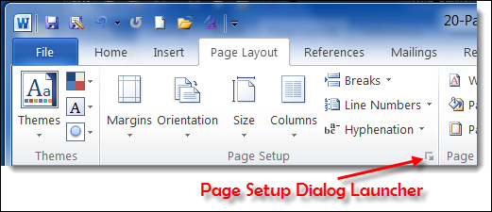
Page Setup

Slide 26
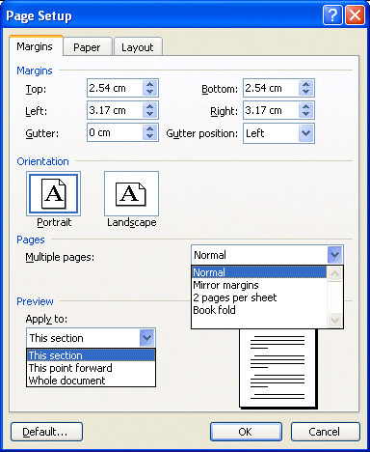
Set Margins
Preview

Slide 27
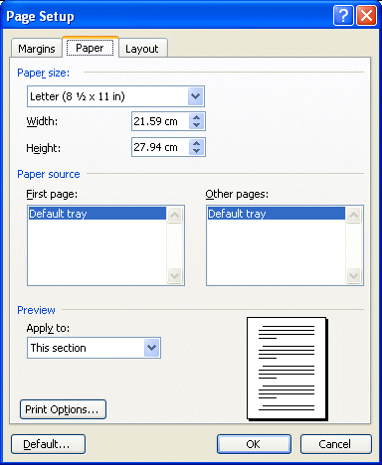
Paper Setup
Preview

Slide 28
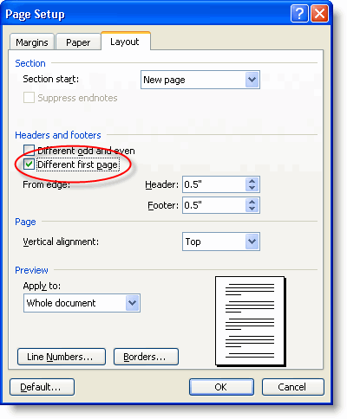
Layout
Setup
Preview

Slide 29
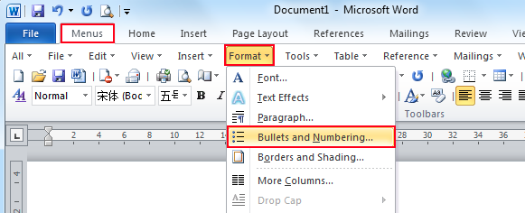
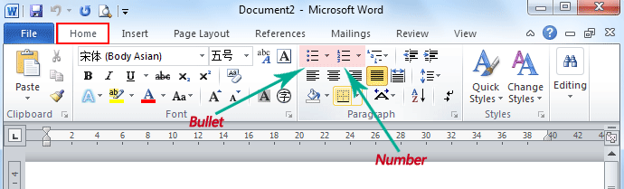
Bullets and Number
OR

Slide 30
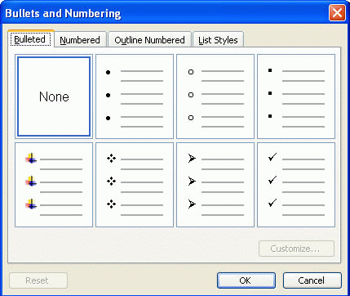
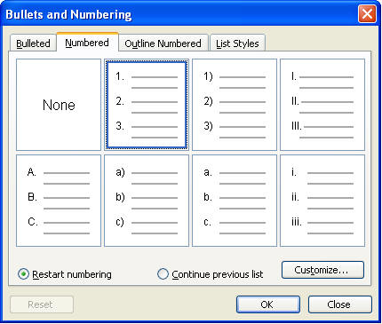

Slide 31
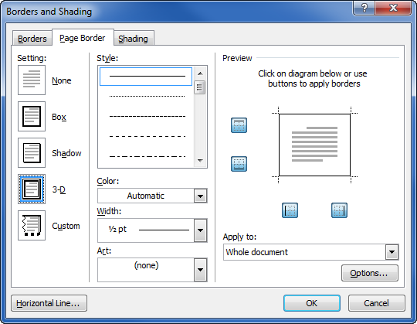
Borders and Shading
Border Preview
Select border width
Select border style
Select border color

Slide 32
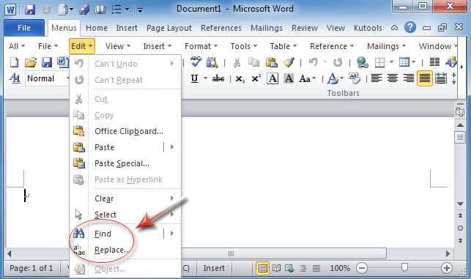
Searching a word and replacing it by another word

Slide 33
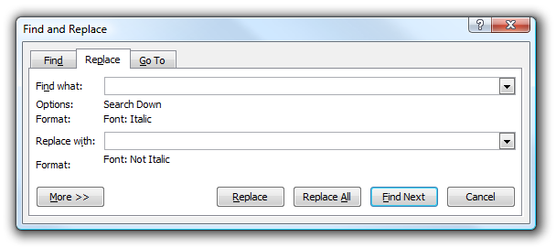
Type word you want to replace
It will find your word in document
Type new word you want to add
It will replace all the same word from document
It will replace selected word

Slide 34
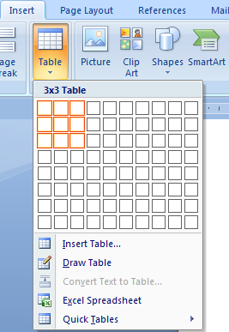
Inserting Table in file
Visually select the size of table
Or click
“ insert table”

Slide 35
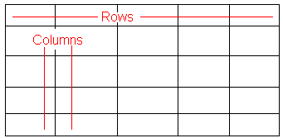
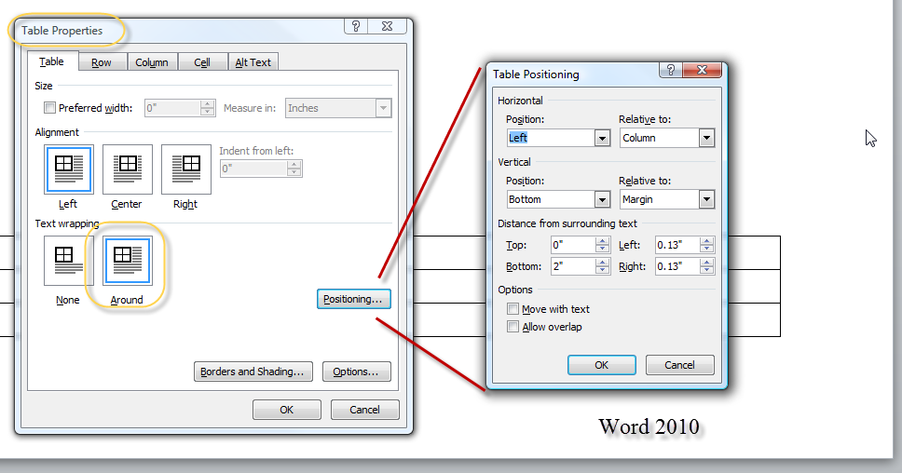
cell

